Slide 1

Vision Based Volumetric Flow Measurement for wastewater and Storm water Networks
SeyedMojtaba Noghabaei
North Carolina State University

Slide 2
Outline
Proposal
Vision-Based Sensor (Application Phase)
Timeline

Slide 3
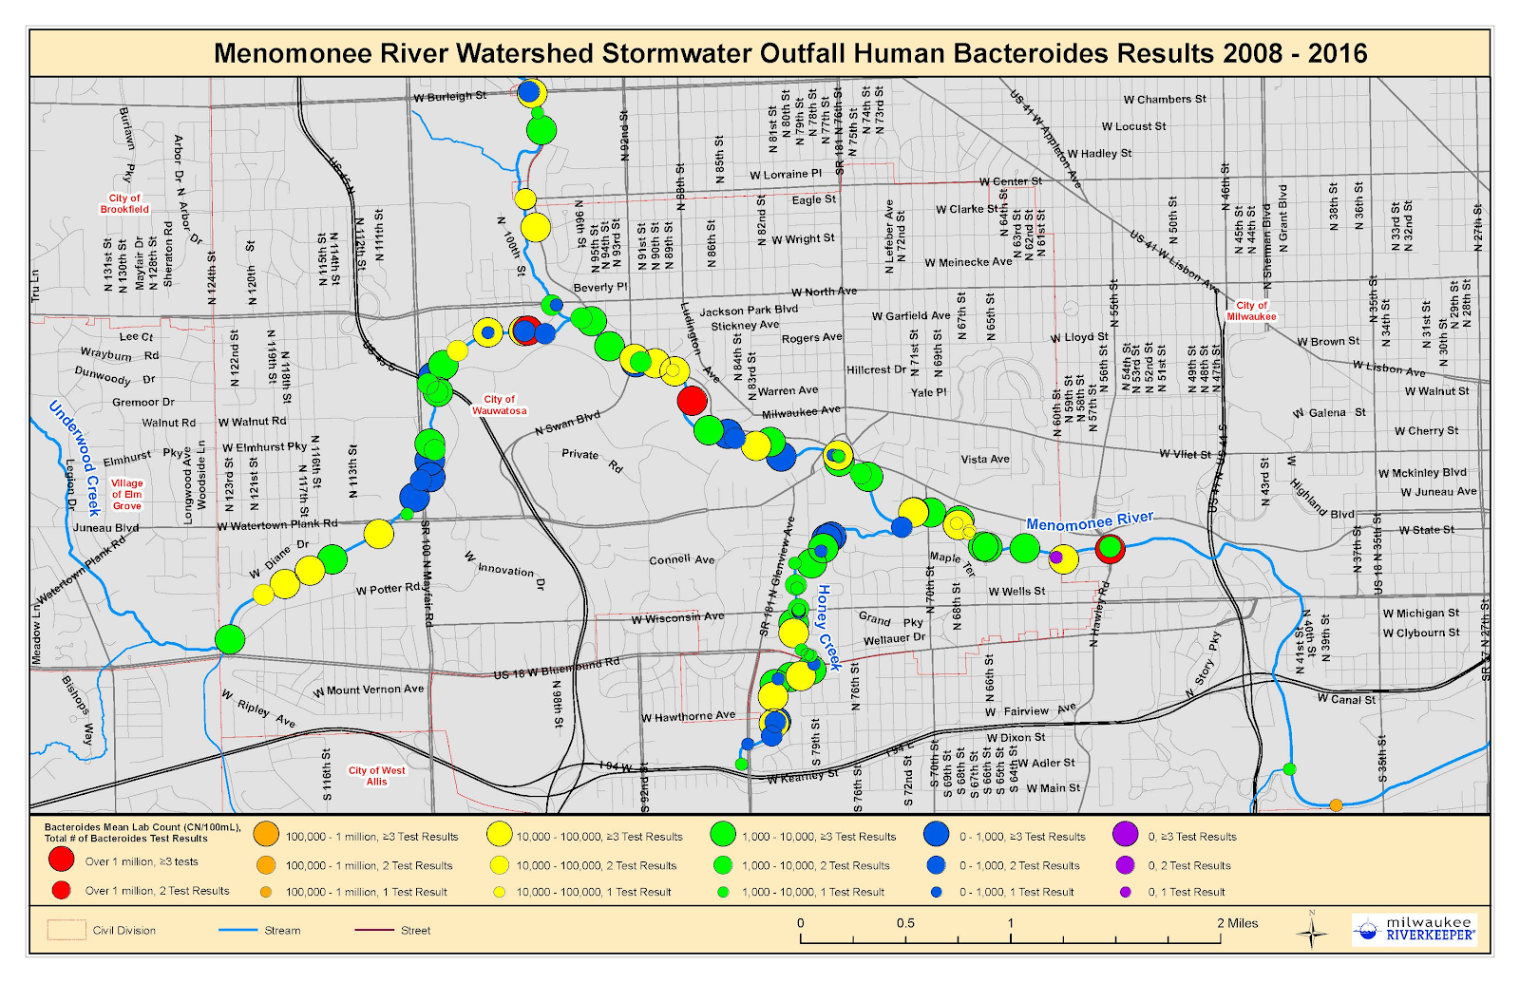
Proposal
Real-time Wastewater Network Monitoring
Notes:
*

Slide 4
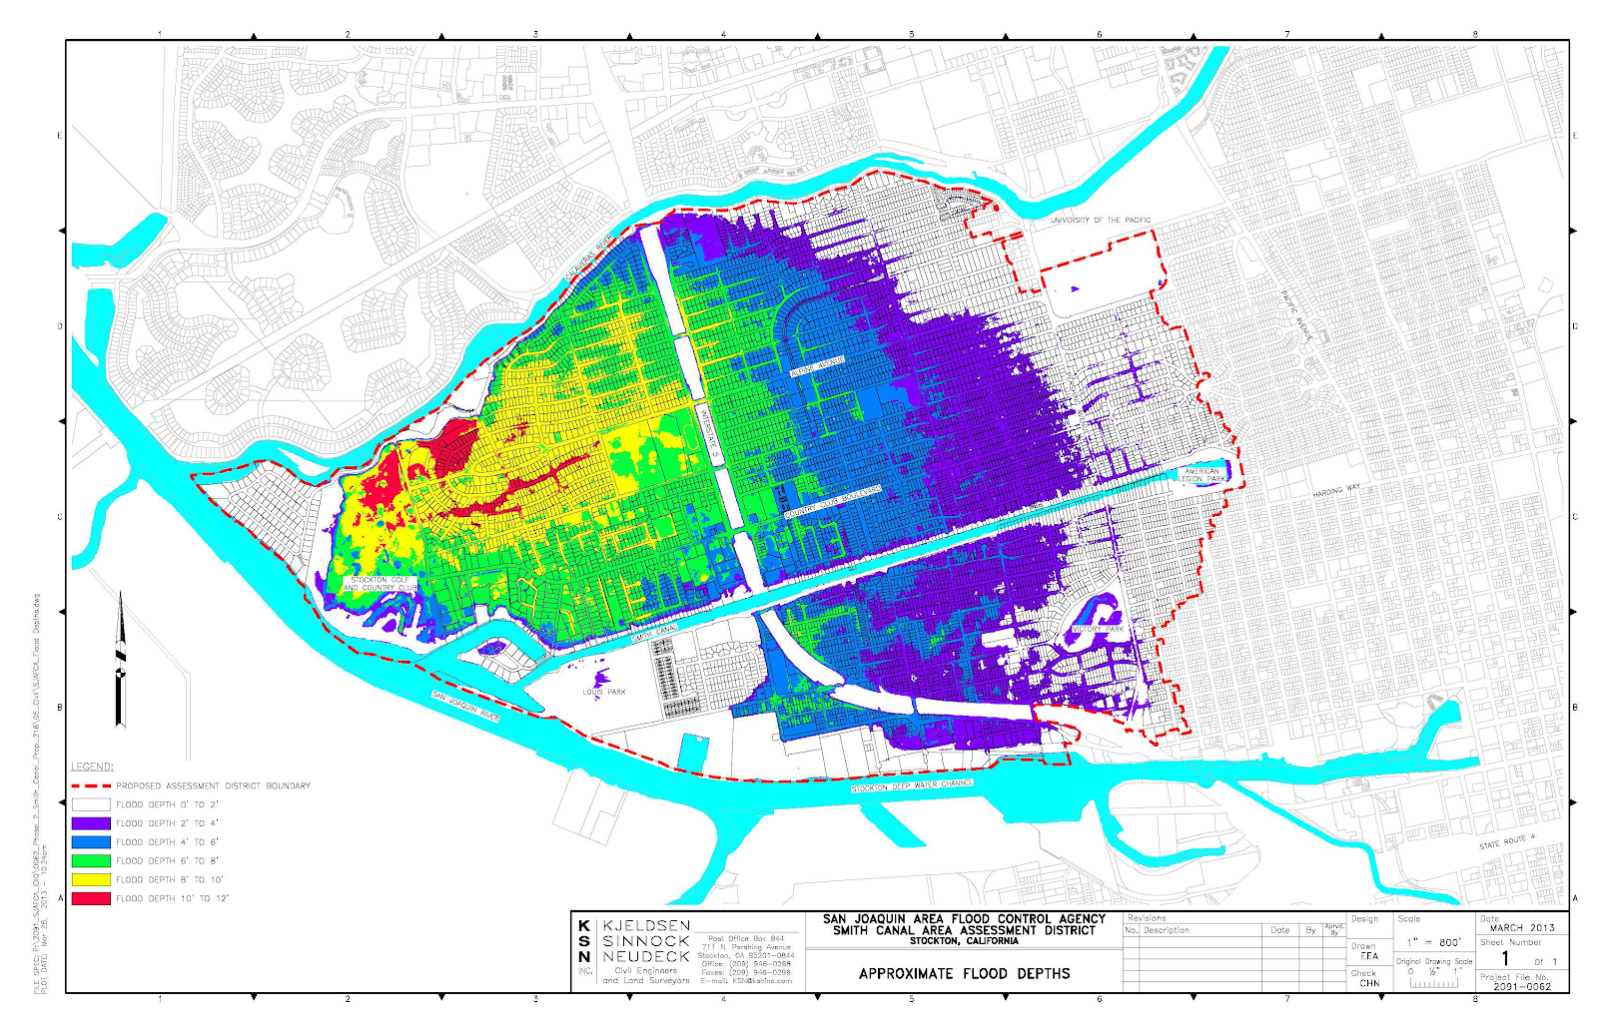
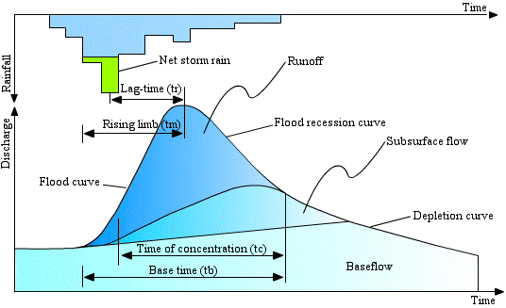
Proposal
Water Flow Mapping and Auto Alert to Citizens
Concentration Time
Alert Citizens Before Overflow
Reduce the Damage
Real-time

Slide 5
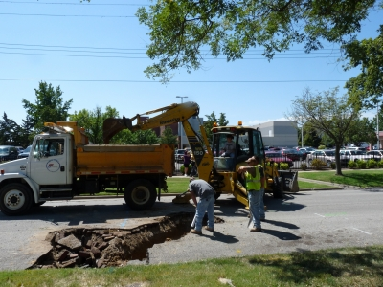
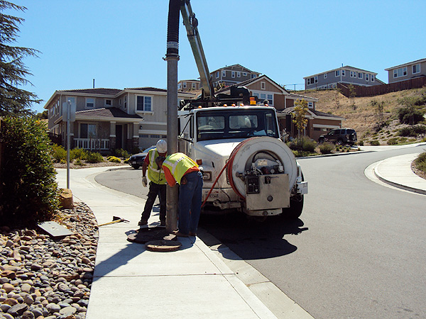
Proposal
Auto Scheduling for Pipe Maintenance
Fixed Budget
Which Pipe?
What kind of Repair?
When?

Slide 6
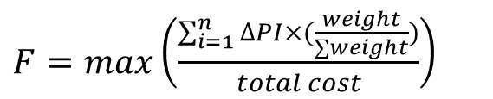
Proposal
Auto Scheduling for Pipe Maintenance
Repair Type # | Repair Option | Cost | Improving PI
1 | Do nothing | 0% | 0
2 | Patch | 5% | 1
3 | Cover Repair | 25% | 2
4 | RFT. Replace | 50% | 3
5 | Rehabilitation | 75% | 4
6 | Replace | 110% | 5
PI# | Condition | Description
9 | NEW | No deficiencies in any of the structural components.
8 | GOOD | All structural components are sound and functioning as designed. There may be superficial cracking or weathering of components.
7 | GOOD | Insignificant cracks or moderate cracks that are sealed.
6 | FAIR | Unsealed moderate-width or map cracks. Minor delamination, spalling, or efflorescence without buildup or rust staining.
5 | FAIR | Moderate delamination, spalling, or efflorescence. Reinforcement exposure without section loss.
4 | POOR | Considerable cracking, spalling, and efflorescence with heavy build-up or rust staining.
3 | SERIOUS | Considerable areas of spalling, exposed reinforcement with section loss, or heavy rust staining
2 | CRITICAL | Deterioration has progressed to the point where the structure will not support design loads and posting, emergency repairs.
1 | IMMINENT FAILURE | Network is closed due to pier failure, but corrective action may put it back in service.
0 | FAILURE | Network is closed due to condition.
Elements | Weight
Main Channels | 10
Main Pipes | 8
Manholes | 6
Sensors | 5
Pipes | 4
$F=max\left(\frac{\sum_{i=1}^{n}{∆PI×(\frac{weight}{∑weight})}}{total cost}\right)$
Notes:
Genetics Algorithm

Slide 7
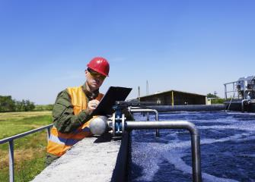
Proposal
Pipe Block and Leakage Detection and Auto Alerts to Technicians

Slide 8
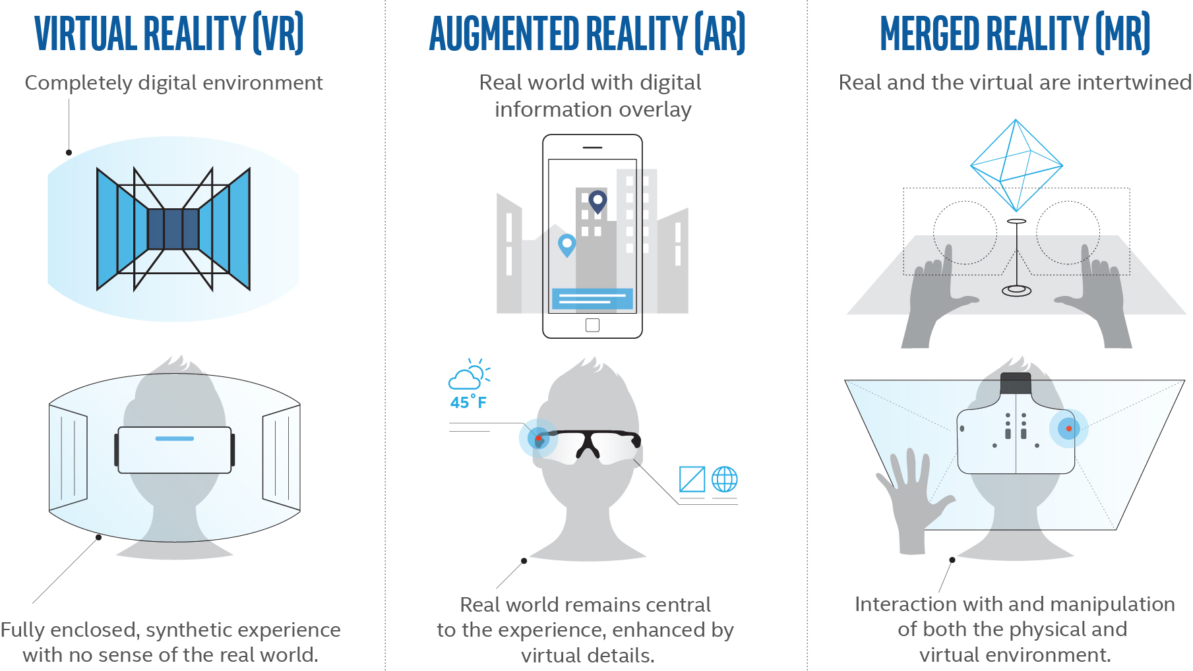

Proposal
Immersive Virtual Environments for Better Management, Collaboration and Visualization
https://www.youtube.com/watch?v=xXy7lbs-D48

Slide 9

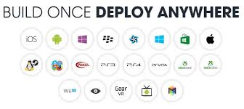
Proposal
Cross-Platform System
Windows
Android
IOS

Slide 10
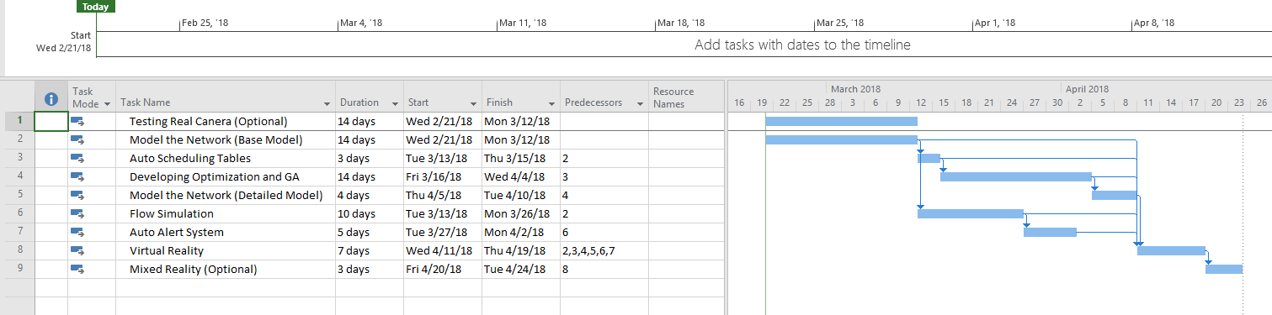
Timeline
Task Name | Duration | Start | Finish | Predecessors
Testing Real Canera (Optional) | 14 days | Wed 2/21/18 | Mon 3/12/18
Model the Network (Base Model) | 14 days | Wed 2/21/18 | Mon 3/12/18
Auto Scheduling Tables | 3 days | Tue 3/13/18 | Thu 3/15/18 | 2
Developing Optimization and GA | 14 days | Fri 3/16/18 | Wed 4/4/18 | 3
Model the Network (Detailed Model) | 4 days | Thu 4/5/18 | Tue 4/10/18 | 4
Flow Simulation | 10 days | Tue 3/13/18 | Mon 3/26/18 | 2
Auto Alert System | 5 days | Tue 3/27/18 | Mon 4/2/18 | 6
Virtual Reality | 7 days | Wed 4/11/18 | Thu 4/19/18 | 2,3,4,5,6,7
Mixed Reality (Optional) | 3 days | Fri 4/20/18 | Tue 4/24/18 | 8

Slide 11
Thank You

